Slide 1

Automotive Communication Stack
- Durga Venkata Shyam Sundar Mandala & Karthikeyan KS

Slide 2
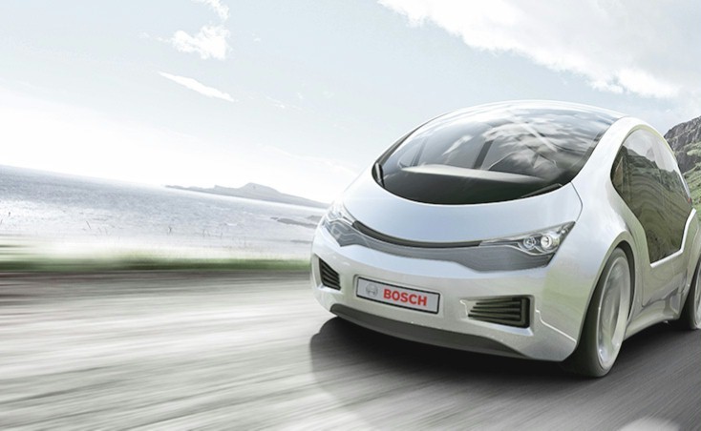

Automotive Communication Stack
Agenda
Overview – Lin, CAN, FlexRay, Eth
Autosar COM Stack -
MCAL
ECU Abstraction Layer
Service Layer
COM Flow Path
02

Slide 3



Overview

Slide 4
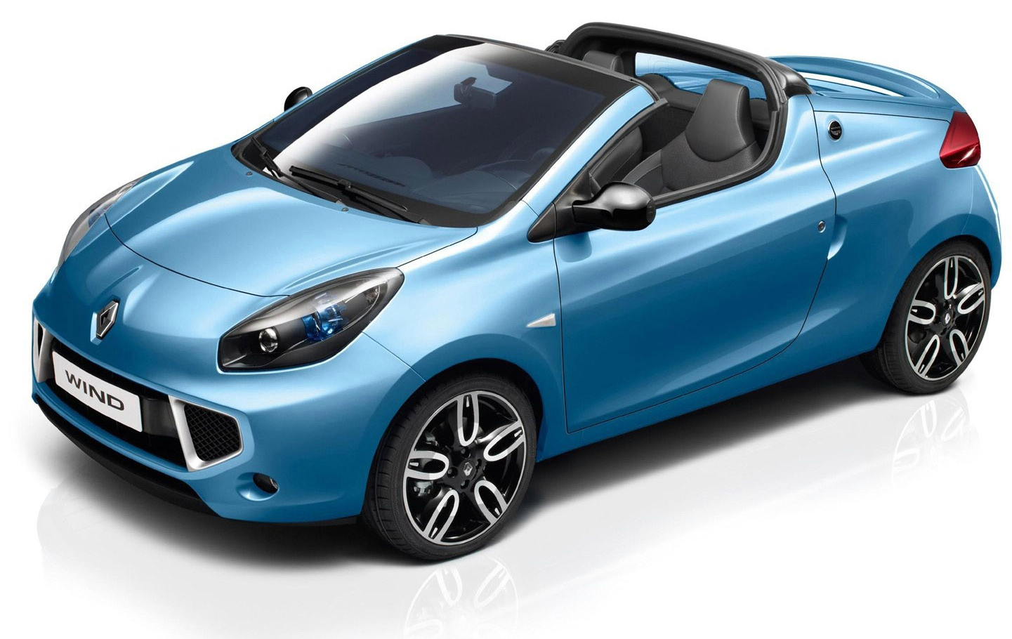
Automotive Communication Stack
Overview
Video
Steering Control
Todays vehicles have many ECU’s each carrying out a specific functionality. Communication between these systems is essential for the effective function of the vehicle
Why?
Point to Point Communication:
More cable length & weight
More material Cost
Installation is extremely difficult & complex
Maintenance is challenging
USS parking sensor
Radar
Brake ECU
04

Slide 5
Automotive Communication Stack
Overview
Video
Steering Control
BUS Topology
Easy to Install
Less cable length & less cost
Maintenance is simple
Easy to add more devices in a network
In modern vehicles major safety critical functions are controlled via In vehicle communication. So If a vehicle network isn’t properly protected, hackers can steal data or even take control of the vehicle.
USS parking sensor
Radar
Brake ECU
05

Slide 6


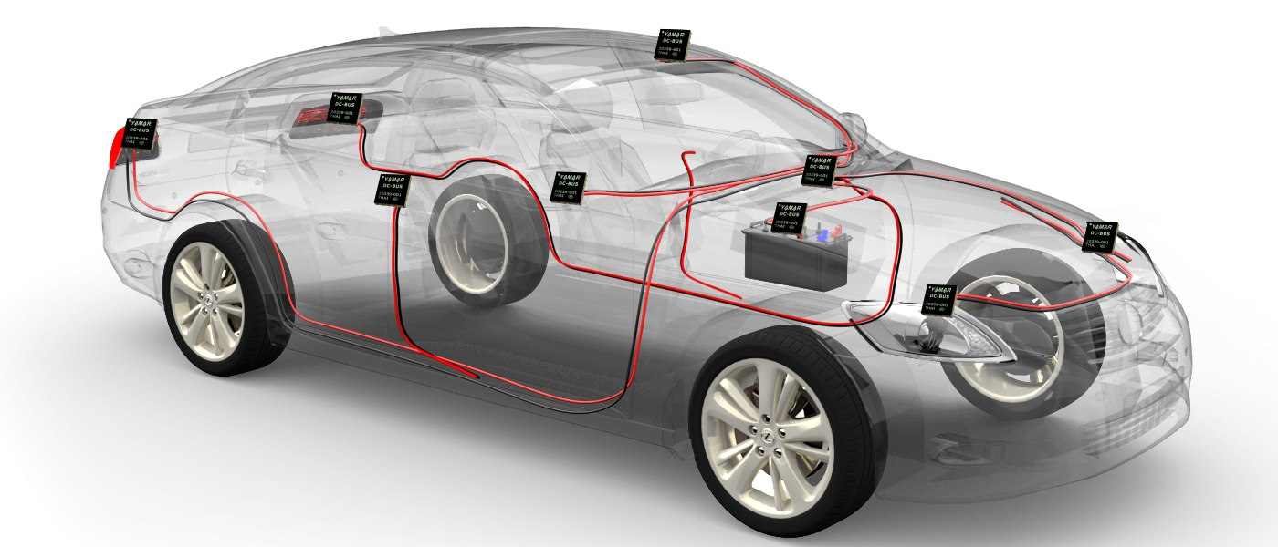


Automotive Communication Stack
Overview
Communication Network Protocols
Controller Area Network
06

Slide 7
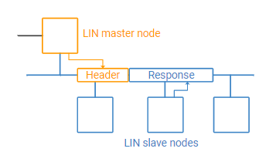
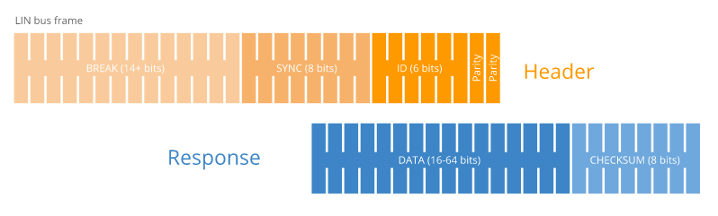
Automotive Communication Stack
Overview - LIN
LIN is a low-speed asynchronous bus offering a data rate of up to 20kbps,
Operating voltage of 12V
Physical layer is based on ISO 9141 (K-line)
low cost and single wire communication network used in the non-critical applications like window lift, doors switches, door lock, seat positioning motors, seat switches, wiper control, light switches, etc.
Implemented using the UART/SCI interface in microcontroller
Typically, < 12 nodes, (64 identifiers & relatively low transmission speed)
LIN network uses master-slave architecture where master controls the medium access: no arbitration or collision management guaranteed latency times
07

Slide 8

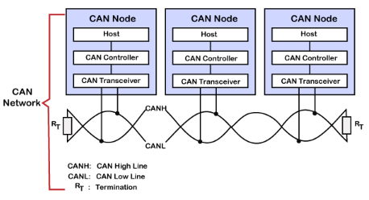
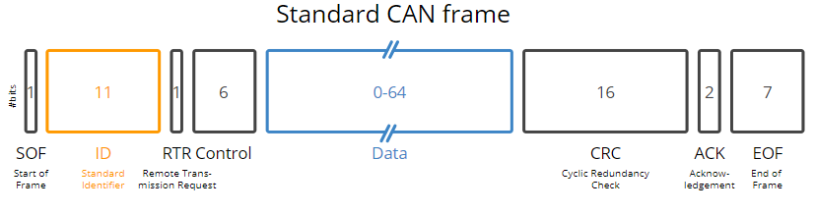
Automotive Communication Stack
Overview - CAN
CAN is a medium speed asynchronous bus offering a data rate of up to 1Mbps
CAN was developed by Bosch in late 1980s and standardized as ISO 11898
Twisted pair wire as the physical transmission medium based on multi-master architecture.
ISO 11898 describes the CAN Data link layer & Physical layer
All nodes can send a message at any time, when two nodes are accessing the bus together, arbitration decides who will continue
Standard CAN supports 11 bit identifier & Extended CAN supports 29 bit identifier
CAN supports MAX payload size of 8 bytes.
CAN-FD(Flexible Data Rate) is introduced to achieve High data rate(8 Mbps) and larger payload(Upto 64 bytes).
Controller Area Network
08

Slide 9
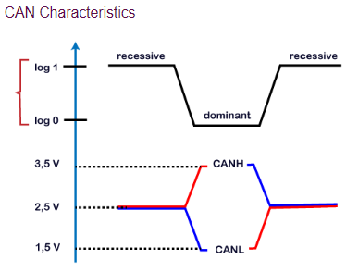
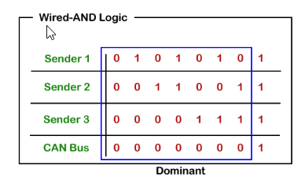

Automotive Communication Stack
Overview – CAN Bus Logic
Logic 1 is a recessive state. To transmit 1 on CAN bus, both CAN high and CAN low should be applied with 2.5V.
Logic 0 is a dominant state. To transmit 0 on CAN bus, CAN high should be applied at 3.5V and CAN low should be applied at 1.5V.
The ideal state of the bus is recessive.
If the node reaches the dominant state, it cannot move back to the recessive state by any other node.
Controller Area Network
Recessive
09

Slide 10
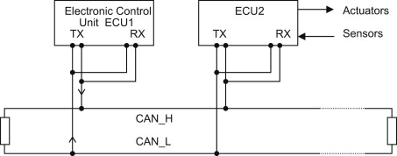
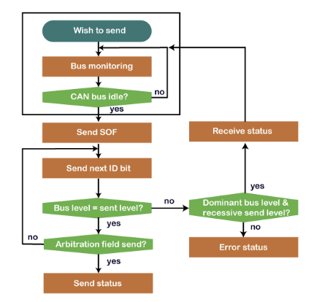
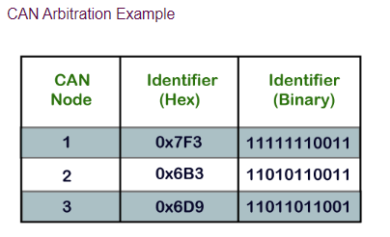
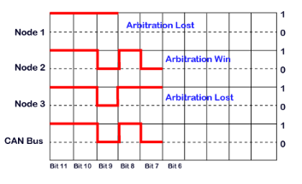
Automotive Communication Stack
Overview – CAN Arbitration
CAN Node Tx & Rx pins are connected to the same Bus point, So a CAN node always receive its own transmitted value and compare it during arbitration phase.
If the received bit is different than the transmitted bit during arbitration, the Node understand that it lost the arbitration, so it will switch to listening mode and retry in the next arbitration phase.
Controller Area Network
10

Slide 11
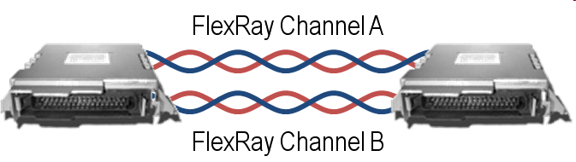
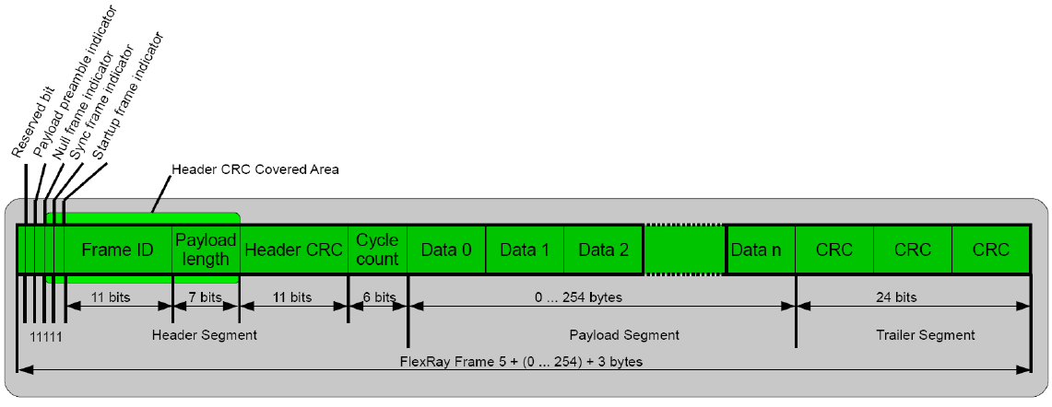
Automotive Communication Stack
Overview – FlexRay
FlexRay was developed by FlexRay Consortium (BMW, Bosch, Daimler Chrysler , Freescale , General Motors , Phillips and Volkswagen ) and standardized as ISO 17458-1 to 17458-5
Transmission rate up to 10Mbit/s
Redundant communication channels – to transmit data redundant, or to double the data rate(upto 20Mbps).
Reliability of transmission – Transmission of information should be reliable and have deterministic timing, since the CSMA method used by the CAN bus can lead to massive fluctuations in timing.
11

Slide 12
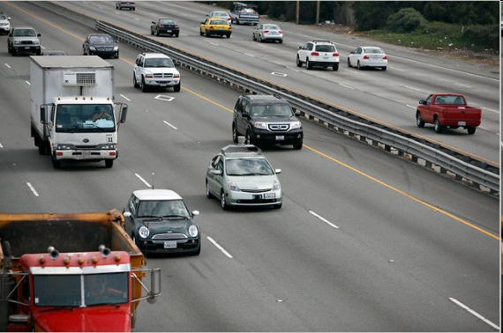

Automotive Communication Stack
Overview – FlexRay
Deterministic and Time Triggered
CSMA
(CAN)
TDMA
(FlexRay)
12

Slide 13

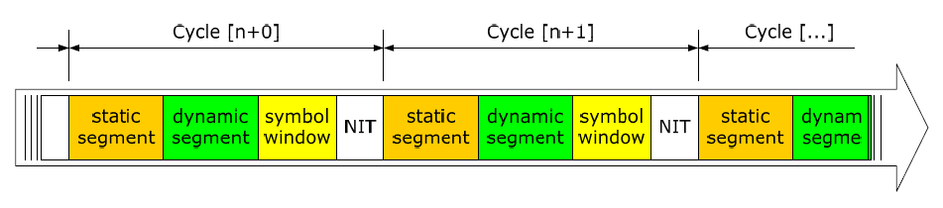
Automotive Communication Stack
Overview – FlexRay
1 FlexRay cycle = 64 Communication Cycle (CC)
1 CC = 5ms
1 FlexRay cycle = 64(CC) * 5 ms = 320ms
1 CC is divided into Static Segment, Dynamic Segment, Symbol window, Network Idle Time
Static Segment and NIT are mandatory
Dynamic Segment and Symbol window are optional
Symbol window used to check the Bus Guardian
During NIT no communication Used to synchronise ECU’s
13

Slide 14
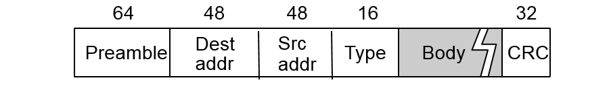
Automotive Communication Stack
Overview – Automotive Ethernet
Bandwidth: supports guaranteed ,high rate(100 MB to 10/100 GB)
Established and stable: high quality and less failure risk
Scalability: LAN/WAN, fieldbus, automotive, …
Interoperability: with WiFi, 3G, 4G, …
OPEN: expandable and adaptable, keeps increasing without end in sight!
Flexible ISO/OSI model: layer separation
Each protocol is specialist on his layer: interface to be good specified
Ethernet is 2nd layer: no PHY dependencies / domain specific upper layer protocols are
Contributes to fuel economy
wiring harness is the 3rd highest cost and heavy component in a car.
Ethernet will help reduce this .
14

Slide 15
Automotive Communication Stack
Overview – Automotive Ethernet
 | Ethernet | Flexray
Bandwidth | 100 Mbit/s | 10 Mbit/s
Transmission | Suitable for video data due to higher bandwidth. | Suitable for Time critical control data due to determinism & redundancy.
Access Method | CSMA/CD | TDMA
Cost | Cheaper with BroadR-Reach | Costlier because of mechanical parts .
Fault Tolerance | less capable in fault tolerance, is still quite promising in time-critical transmission | fault tolerant, optimal in applications such as steering and brake controls
15

Slide 16


Autosar COM Stack

Slide 17
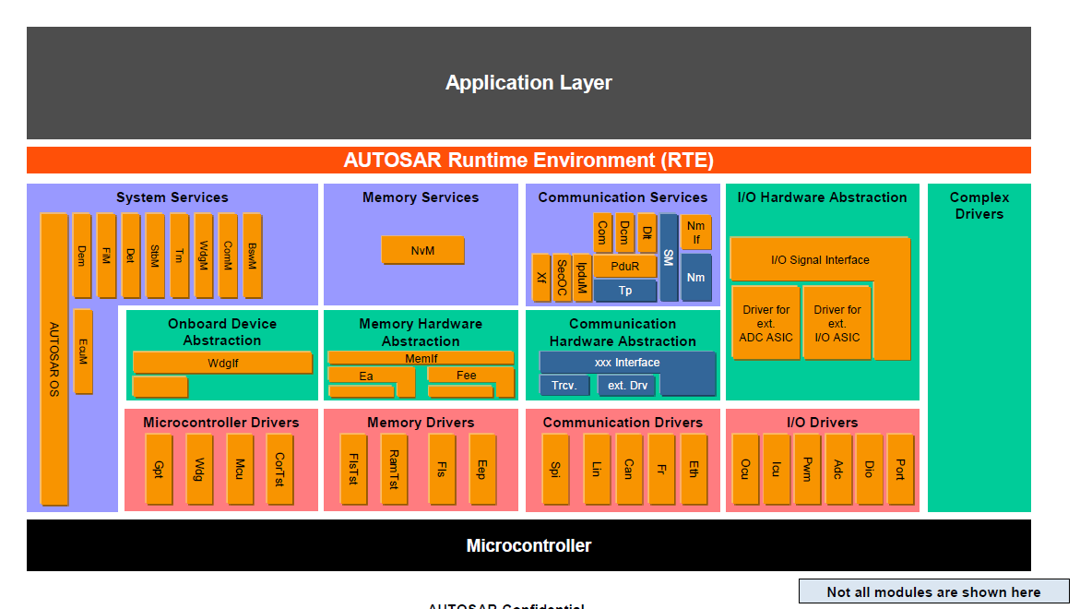
Automotive Communication Stack
Overview - Landscape
17

Slide 18
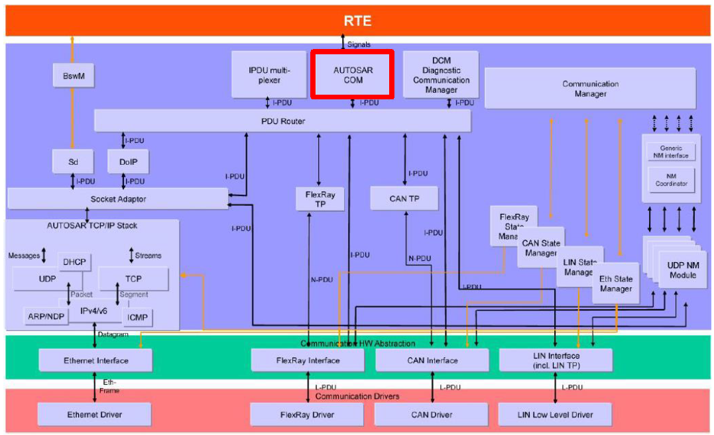
Automotive Communication Stack
Overview – COM Stack
Service Layer
ECU Abstraction
MCAL
18

Slide 19

Microcontroller Abstraction Layer

Slide 20
Automotive Communication Stack
Overview – COM Stack
This specification specifies the functionality, API and the configuration of the AUTOSAR Basic Software module CAN Driver, Flexray Driver, Eth Driver.
This module is part of the lowest layer, performs the hardware access and offers a hardware independent API to the upper layer.
20

Slide 21
ECU Abstraction Layer

Slide 22
Automotive Communication Stack
Overview – COM Stack
Interface (CANIF, Flexray IF, EthIF) is a module in the ECU Abstraction Layer, which is responsible for services like Transmit Request, Transmit Confirmation, Reception Indication, Controller mode control and PDU mode control.
22

Slide 23
Service Layer

Slide 24
Automotive Communication Stack
Overview – COM Stack
Communication Services provides Application Layer an access to vehicle network communication (CAN, Ethernet, LIN and FlexRay).
PDU Router:
Provides routing of PDUs between different abstract communication controllers and upper layers
Scale of the Router is ECU specific (down to no size if e.g. only one communication controller exists)
Provides TP routing on-the-fly. Transfer of TP data is started before full TP data is buffered
AUTOSAR COM:
Provides routing of individual signals or groups of signals between different I-PDUs
NM Coordinator: (CAN NM, Flexray NM, Eth NM, etc)
Synchronization of Network States of different communication channels connected to an ECU via the network managements handled by the NM Coordinator
Communication State Managers: (CAN SM, Flexray SM, Eth SM, etc)
Start and Shutdown the hardware units of the communication systems via the interfaces
Control PDU groups
Transport Module (CAN TP, Flexray TP)
Transport layer for segmented transmission. Components CAN TP, FlexRay TP, etc
DCM
Diagnostic Communication manager handle ISO 14229 defined diagnostics services
COMM (Communication Manager)
Simplifying the usage of the bus communication stack for the user. This includes a simplified network management handling. Handles modes like Full Communication, Silent Communication, No Communication
24

Slide 25
COM Flow Path

Slide 26
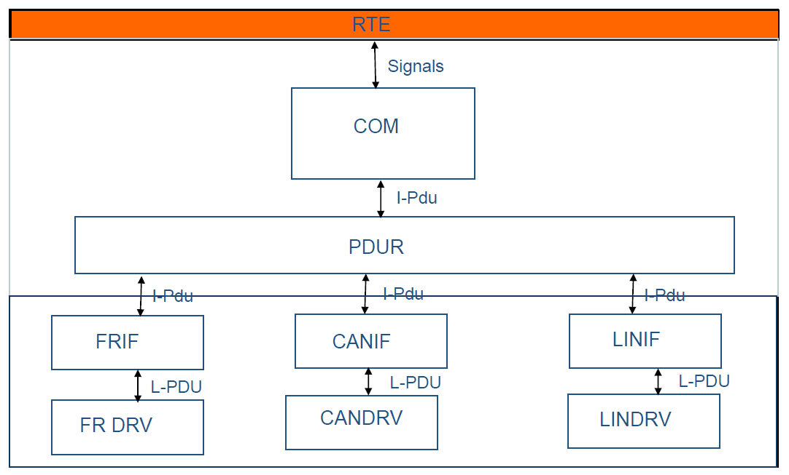
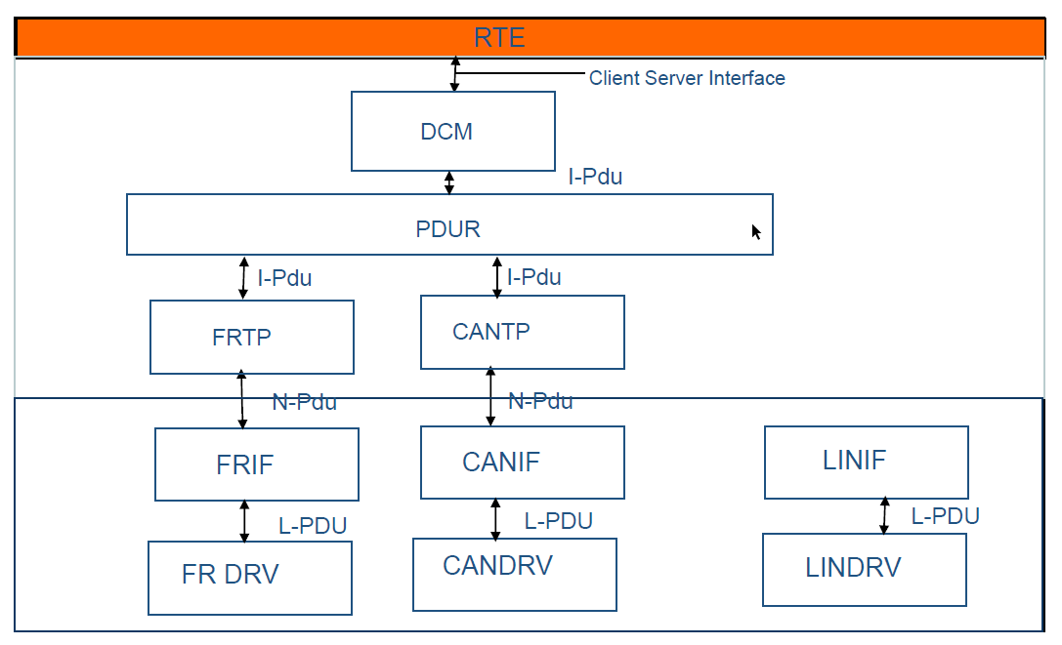
Automotive Communication Stack
COM Data Path
Diagnostics Data Path
Naming of PDU’s
ISO Layer | Autosar Modules | PDU Name
Presentation (Interaction) | COM, DCM, PduR | I-PDU
Network Layer | Transport Layer(CAN-TP, FR-TP, etc) | N-PDU
Data Link Layer | Driver, Interface (CAN-IF, CAN, FR-IF, etc) | L-PDU
26

Slide 27

Thank you!

